Slide 1
Conceptual, methodological and practical issues in spatial data integration – designing the GeoSocial service
Wojtek Tomaszewski
Institute for Social Science Research
The University of Queensland

Slide 2

Acknowledgment of Country
The University of Queensland (UQ) acknowledges the Traditional Owners and their custodianship of the lands on which we meet.
We pay our respects to their Ancestors and their descendants, who continue cultural and spiritual connections to Country.
We recognise their valuable contributions to Australian and global society.
Notes:
Guidelines for use:
Use this slide when presenting at UQ or at any site in Australia, when appropriate.
Remember to pause briefly after acknowledging Country as a sign of respect.
If you are more familiar with acknowledging Country you may add a statement about the event, meeting or forum’s connection with Country. For example; at a higher education event you might acknowledge that the campus has always been a space for teaching, learning, research and collaboration tens of thousands of years before it was established as a university campus, and continues today.
When to use longer version:
If you are the main speaker at the event/gathering
If you are the first person to present.
When to use a shorter version:
If you are not the first person to acknowledge Country
In a more informal setting
Thanking a Traditional Owner for welcoming people to Country.
Longer version
I acknowledge the Traditional Owners and their custodianship of the lands on which we meet today. (On behalf of *) I pay our respects to their Ancestors and their descendants, who continue cultural and spiritual connections to Country. We recognise their valuable contributions to Australian and global society.
* If you are hosting an event, meeting or seminar, you might say something like “On behalf of the event organisers or your section….”
Shorter version
I (too,) acknowledge the Traditional Owners and their custodianship of the lands on which we meet today and pay my respect to their Ancestors and their descendants.
Slide last updated June 2019 – content owner is PVC(IE)/ATSISU (contact Nell Angus).

Slide 3
Opportunities and barriers
Getting data ‘research ready’
Opportunity:
Integrated data on people and places (and time) provides unique opportunities for social science research
Growing interest in place-based approaches among policy makers
Current landscape:
Fragmented data
Lacking ‘good’ documentation (particularly concerning technical data/issues)
(Spatial) data integration demands deep technical and methodological knowledge
Consequences:
Duplication
Lack of consistency given need for individualised approaches; lack of reproducibility/scalability
Time consuming

Slide 4
WP3 GeoSocial: aims & objectives
WP3 GeoSocial aims to design search, retrieval and integration service that can generate data products that integrate people, place, time and space
Linking geospatial statistical data (e.g. Australian Census) to person-centered data from nationally representative longitudinal surveys (e.g. HILDA, LSAY)
Broader objectives: to establish innovative spatially-integrated approaches to social science research that can directly inform local and national efforts to improve people’s lives
empower cross-disciplinary social research using rich integrated geo-social data
inform policy and facilitate social planning across wide-ranging issues relating to population health, social wellbeing and community cohesion

Slide 5
Considering user needs
Advanced user (able to perform advanced data transformations, merging datasets, deriving variables, deploying advanced statistical/analytic methods)
Would still benefit from easy-to-use, trustworthy, transparent, and reproducible solution: saves time and effort on parts of the research process that can be automated
Allow flexibility while providing advice/information on technical issues
Less-advanced users (limited ability to manipulate data; focus on exploratory/descriptive analysis, data visualization)
Broader user base; ability to include non-academic users, e.g. policy departments and service agencies
Service would require significantly more features (e.g. ready-to-use data; additional functionalities allowing data analysis and visualization; features to prevent mis-handling or mis-interpretation of data).

Slide 6
Geo-social data integration: two main scenarios
Service will assist with integration of (longitudinal) survey data with spatially-structured data defined at some level of geography (e.g. postcode, SA2)
Two main scenarios to consider:
Non-survey area information appended to survey household/person unit record data
the resulting dataset is a person-level dataset
allows analysis (e.g. regression modelling) with area-level predictors (with some caveats)
Area information derived from survey through some aggregation process appended to non-survey (area-level) data
the resulting dataset is an area-level dataset, based on some spatial unit
aims to facilitate area-level analysis
Challenges with pursuing either of these options, particularly the second one, in the context of survey data

Slide 7
Challenges: survey data
Sample design – e.g. observations might be geographically clustered and unrepresentative of different geographical units
Patchy coverage
For example, of about 38,200 Collection Districts (CDs) in Australia in 2011, only 488 were selected for the first HILDA wave; all consecutive sampling steps were nested within those 488 CDs
The sampling (and weighting) is not designed to allow building up reliable estimates from the survey to smaller levels of geography, such as suburbs/SA2s, SA3s or LGAs
Usually designed to allow estimates at a state/jurisdiction level (sometimes broken down by metropolitan vs non-metropolitan areas within jurisdictions)
Sample size in surveys – even in large surveys (e.g. HILDA, LSAY) cases can become low when working with small spatial units; exacerbated by attrition in longitudinal surveys

Slide 8
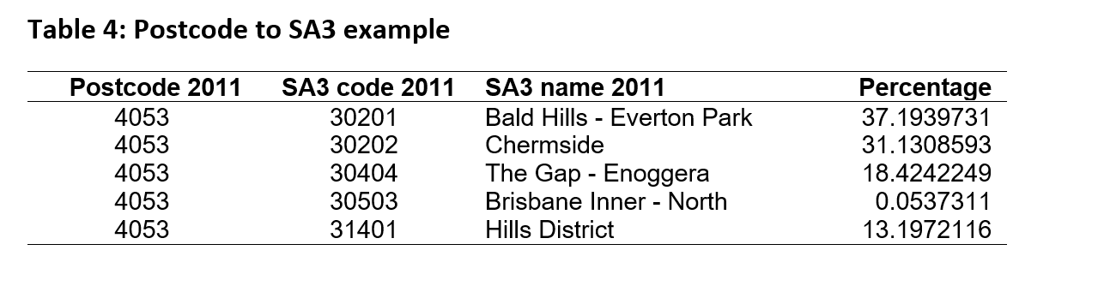
Challenges: concordance between survey and spatial data
Availability of spatial units (and their identifiers) to enable integration
Ideally, the same spatial unit would be available in the survey and non-survey data (e.g. SA2) but this is not always the case
Aggregation: it might be possible to create higher level geographies from the available geographic information using available concordances (e.g. postcode to SA3); however this is not always straightforward
Data quality: examples of invalid postcodes in LSAY that don’t exist in the ABS data (POA) for the same year (aside from the many ABS postal areas which aren’t covered in LSAY)

Slide 9
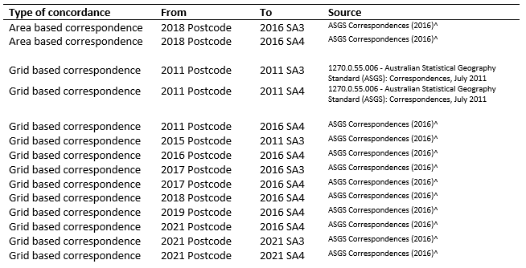
Challenges: longitudinal dimension
Changes to classifications, including geographical classifications
Changes to boundaries of spatial units over time (some, like postcodes, tend to change frequently, with changes poorly documented)
Decisions needed around temporal concordance between different spatial units (which type and time point to use)

Slide 10
Challenges: data access & governance
Access requirements, e.g. establishing a data sharing agreement and/or signing a confidentiality deed poll then registering for the service; downloading the data (an open connection or a secure API)
Requirements depend on the level of spatial unit for integration:
Non-survey area information might not be publicly available at the level of geographical units used in the sampling designs of surveys, such as the CD level
Survey data often has additional requirements/restrictions for spatial data at more granular levels (e.g. comes as part of ‘restricted’ version)
Restrictions associated with safely reporting outputs, e.g. in HILDA reporting at an SA2 level or below is not permitted under the standard HILDA Terms and Conditions of access

Slide 11
Implications for pilot service design
Targeting advanced user: e.g. service in the form of editable scripts integrating data; script repository (scripts written in R) and HTML web page
The GeoSocial service will not be designed with authentication/authorisation or other access mechanisms. The data integration scripts will run within a working environment that is assumed secured
Data governance and privacy: executed in the user’s local computer environment
Connections to other IRISS work package outputs, such as VASSSAL (vocabulary service) and SPIRE (survey package)
Links to relevant external information (e.g. correspondence information from ABS; signup/access AURIN data; metadata, e.g. HILDA, LSAY, ABS), vocabularies
Detailed documentation and warnings/ information on potential issues/ inconsistencies
Pilot services purposefully limited in scope but designed with future evolution/possible extensions in mind (e.g. a wider range of data, a more flexible data integration process, and some analytic solutions)

Slide 12


The IRISS project received investment (https://doi.org/10.47486/HIR002) from the Australian Research Data Commons (ARDC). The ARDC is funded by the National Collaborative Research Infrastructure Strategy (NCRIS).

Slide 13
Thank you
UQ contact: A/Prof Wojtek Tomaszewski
w.tomaszewski@uq.edu.au
Project website: https://ausiriss.org.au/

